Slide 1
Bitcoin price prediction using ML
RISHAV RAJ SINGH (2000271540044)
RAUSHAN KUMAR (2000271540043)
GAURAV SINGH
(2100271549002)
ADITYA KUMAR
(2000271540007)

Slide 2
TABLE OF CONTENTS
01 | INTRODUCTION
02 | PROBLEM OBJECTIVE
03 | LITERATURE REVIEW
04 | METHODOLOGY
05 | IMPLEMENTATION
06 | RESULT AND EVALUATION
07 | DEMONSTRATION
08 | DISCUSSION
09 | CONCLUSION

Slide 3
01
INTRODUCTION
In the recent years, in the terms of market capitalization by value and volume bitcoin is one of the most important cryptocurrency so this is the Primary reason for us to choose it as our subject for research thesis.
Another reason for selection of bitcoin is based on its volatile nature which affects the financial marketers which costs them in monetary value . The price of the bitcoin is fluctuated because of the various reasons such as Company level factors and External factors which include industry shifts, government regulations, or even severe weather that affects company operations.the previous forecasting methods uses the machine learning algorithm for prediction of the bitcoin price based on the historical data and market voices related to the bitcoin.
Our research employs various machine learning algorithms to forecast Bitcoin prices, with the goal of establishing upper and lower limits for these fluctuations.It also does not set the upper and lower boundary for fluctuations in the price of bitcoin.

Slide 4
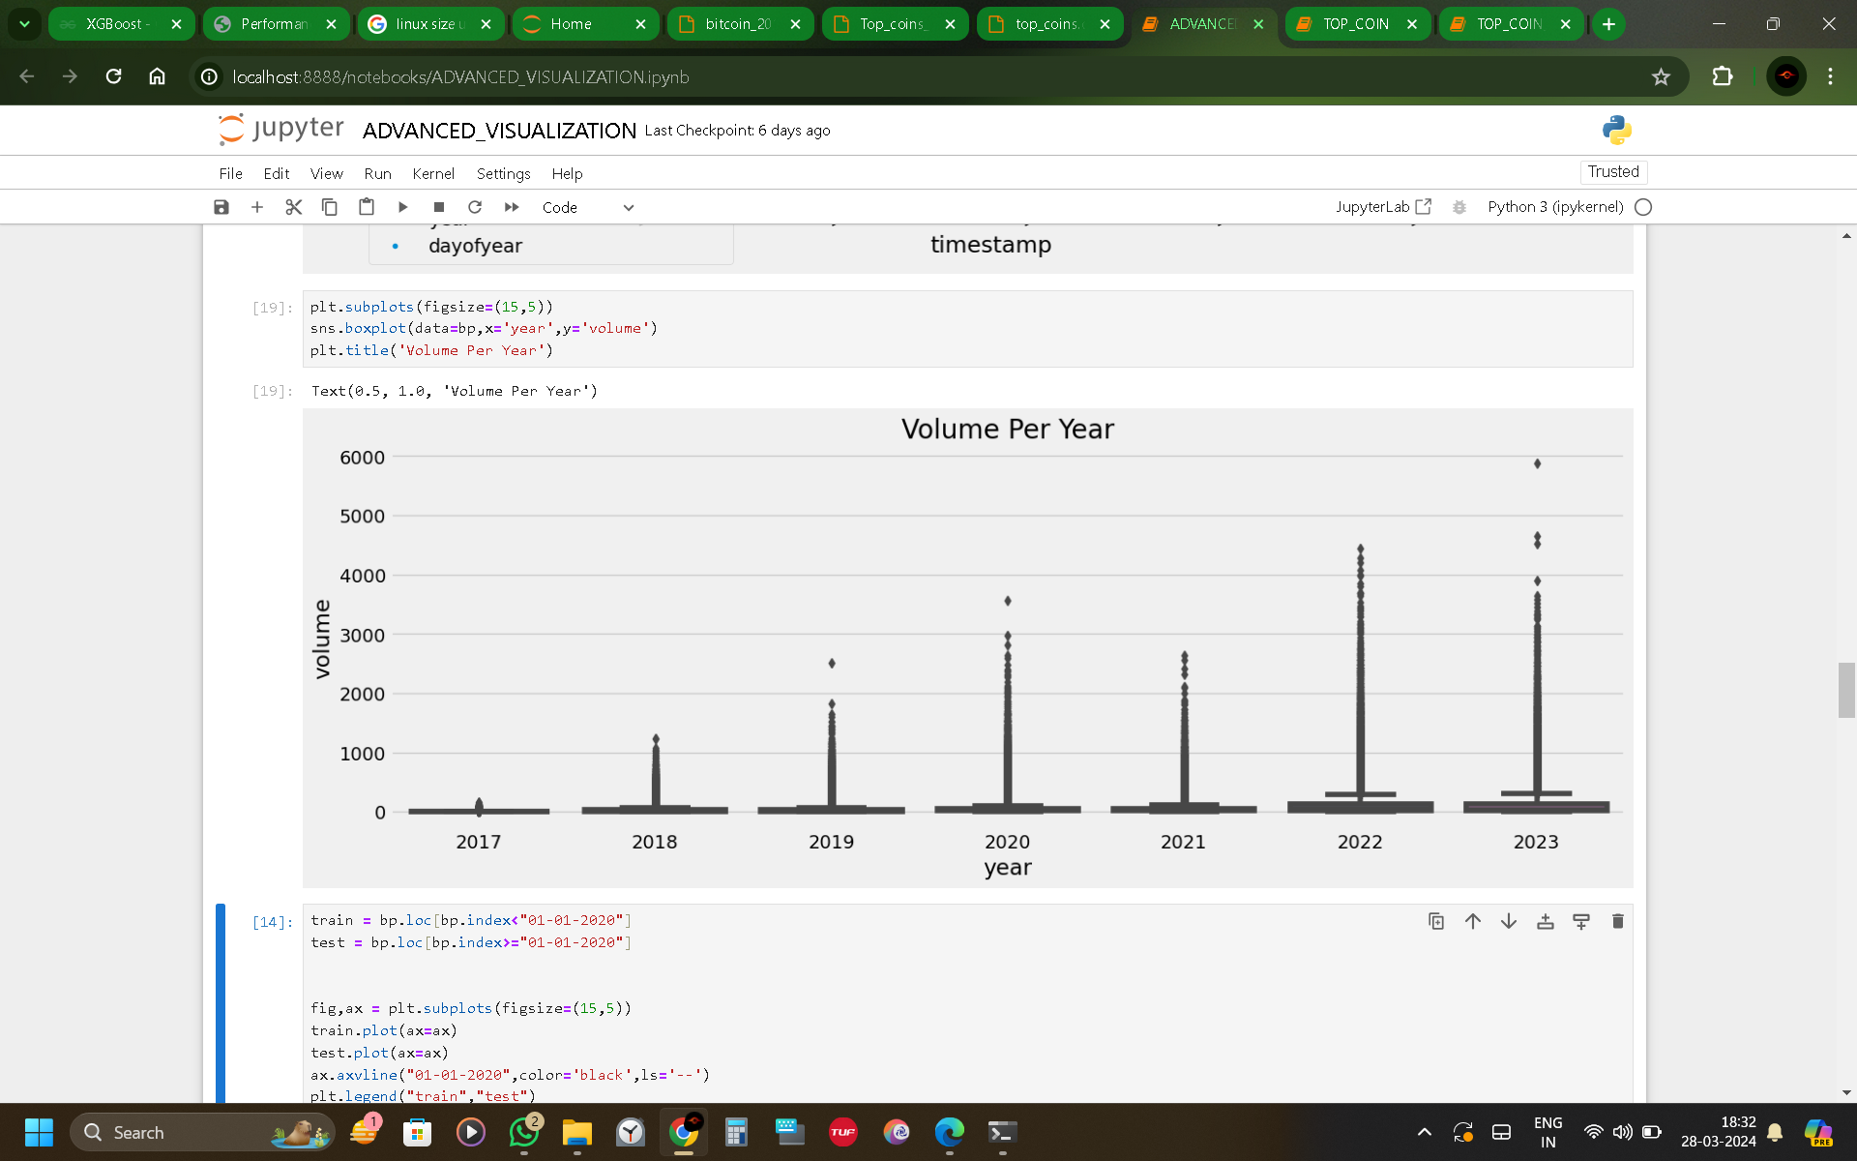
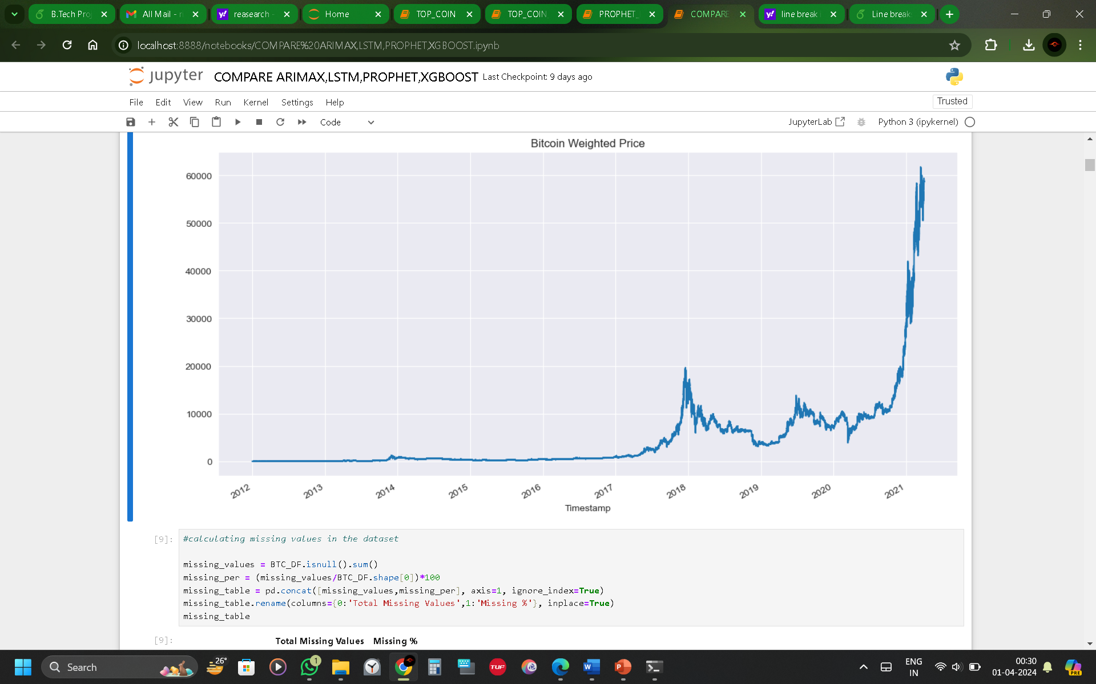
01
VISUALISATION

Slide 5
02
PROBLEM OBJECTIVE
To propose a Machine Learning based model for day-to-day price prediction of bitcoin using historical data.
To predict the forecast price of bitcoin for investors and common people with upper and lower limit price limit so the risk of loss will be reduced.
OBJECTIVE

Slide 6
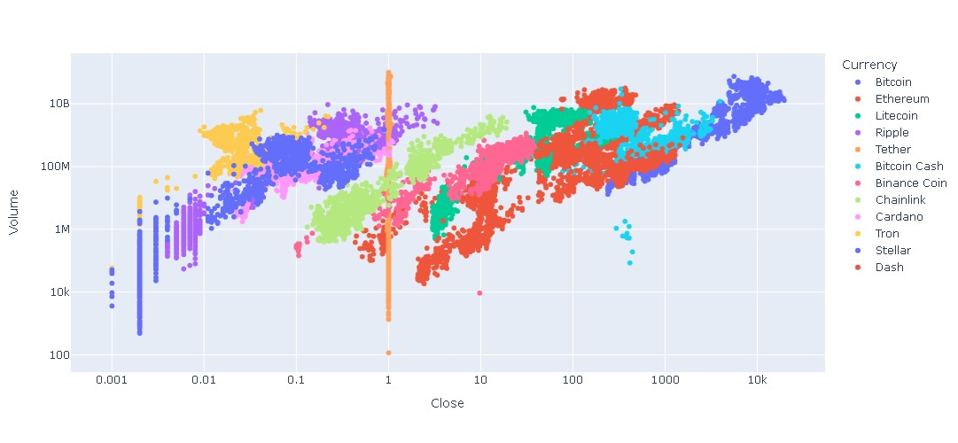
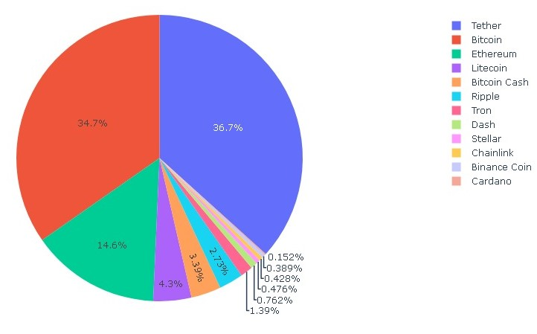
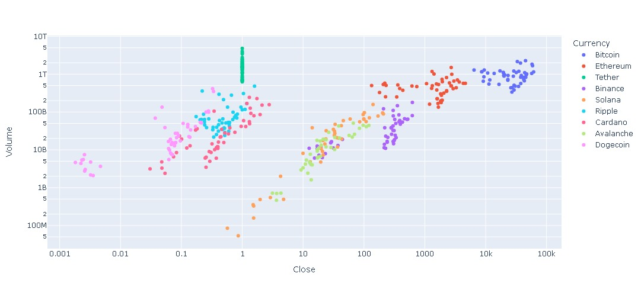
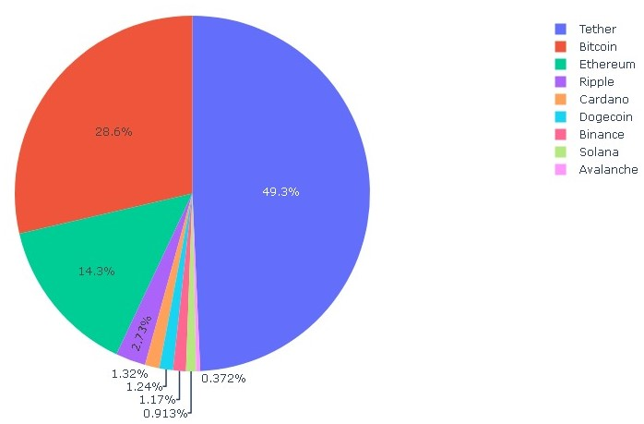
01
VISUALISATION

Slide 7
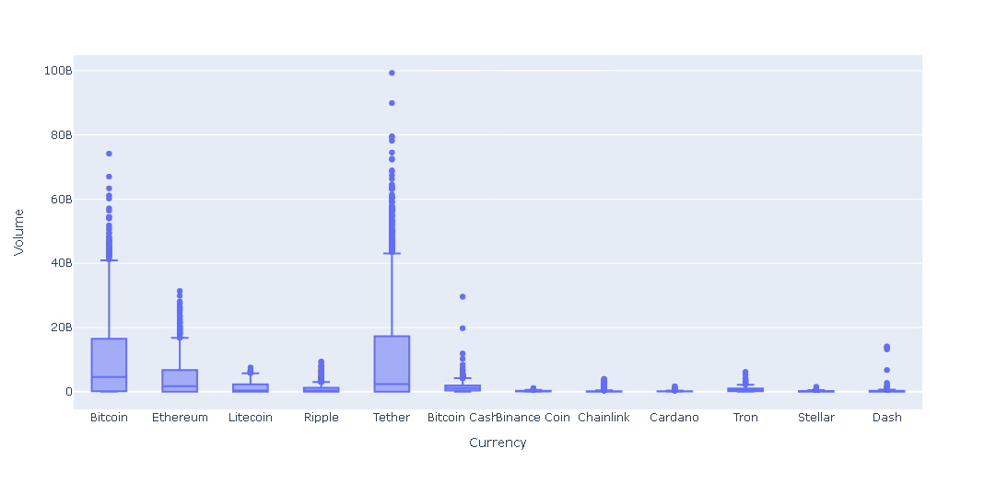
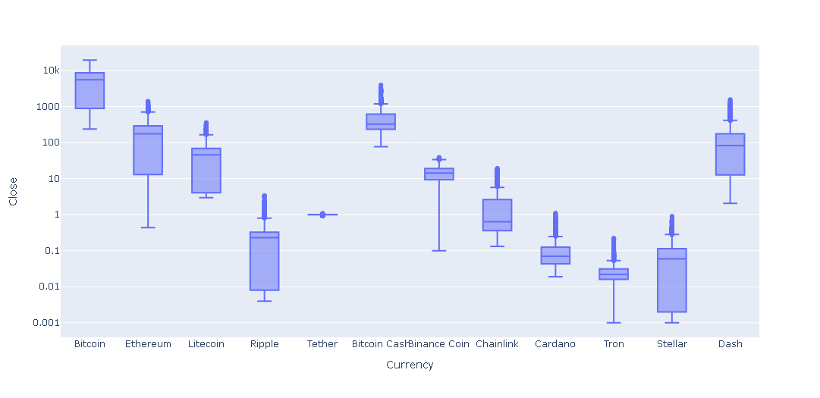
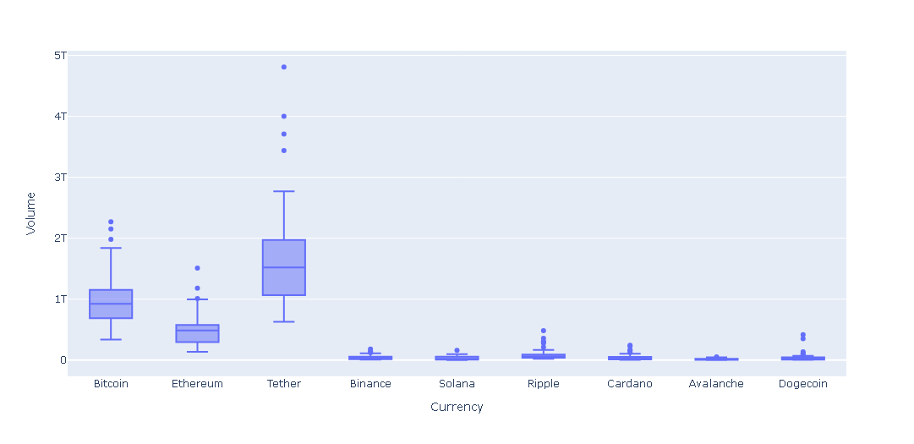
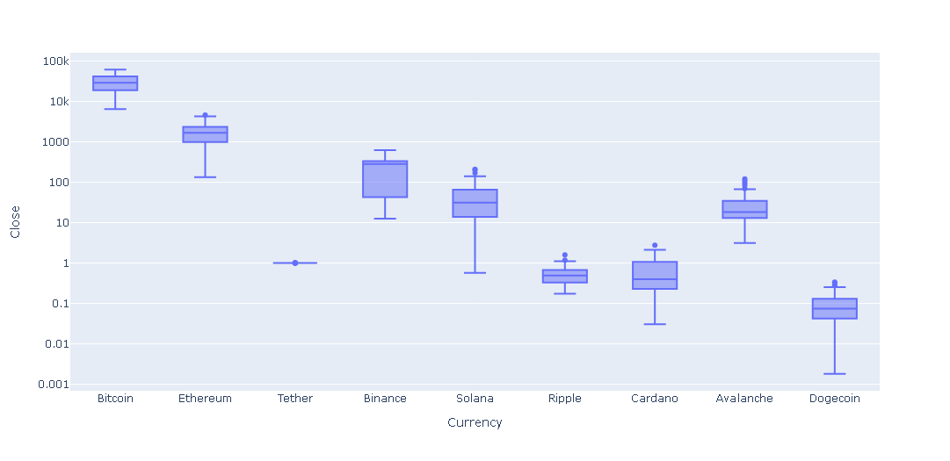
01
VISUALISATION

Slide 8
03
LITREATURE REVIEW
AUTHOR NAME | YEAR | TECHNIQUES | OBJECTIVE | ADVANTAGES
Kanksha and Harjit Singh | 2023 | FB Prophet | Predicting Bitcoin and Litecoin prices | Accurate predictions
Harsh Parikh, Nisarg Panchal, and Ankit Sharma | 2023 | FB Prophet, Linear Regression, Auto-ARIMA | Forecasting cryptocurrency prices | Comparative performance analysis
Yingjie Zhu, Jiageng Ma, Fangqing Gu, Jie Wang, Zhijuan Li, Youyao Zhang, Jiani Xu, Yifan Li, Yiwen Wang, and Xiangqun Yang | 2023 | XGBoost | Predicting Bitcoin prices | Adaptive feature selection and model optimization
Linxi Pan | 2022 | ARIMA , LSTM | Predicting cryptocurrency prices | Comparative analysis of prediction models
Sahil Sejwal, Kartik Aggarwal, Soumya Ranjan Nayak | 2023 | ARIMAX | Time series analysis of cryptocurrency | Better results than ARIMA
Y. Song M. Qiu. | 2020 | LSTM , ARIMA model | Offer a novel predicting architecture based on an LSTM model to anticipate daily bitcoin prices using two LSTM models | The findings supported the suggested models.
Y.B. Kim, J.G. Kim, W. Kim, J.H. I’m, T.H. Kim, S.J. Kang, C.H. Kim | 2021 | Machine Learning | Examines user posts in digital cryptocurrency groups to forecast swings in bitcoin values and trans- action volume. | Large market size and user base datasets are taken.

Slide 9
04
METHODOLOGY

Slide 10
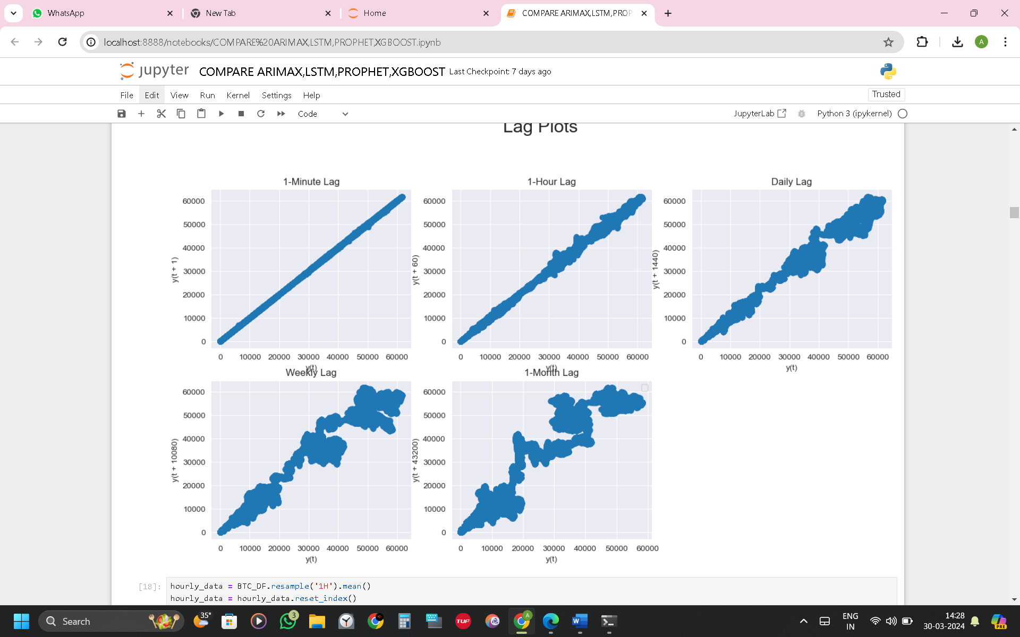
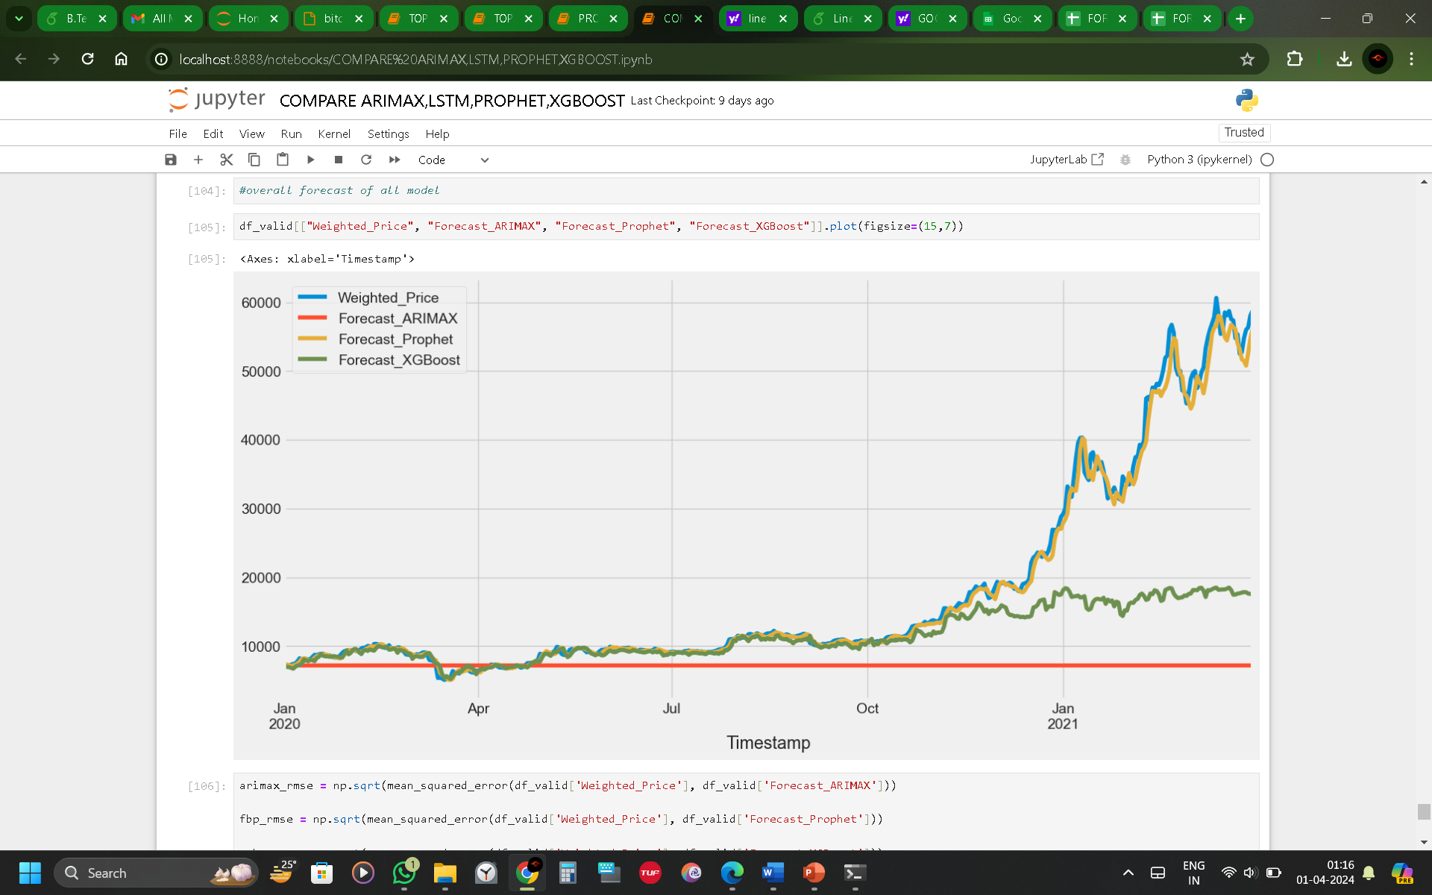
05
IMPLEMENTATION

Slide 11
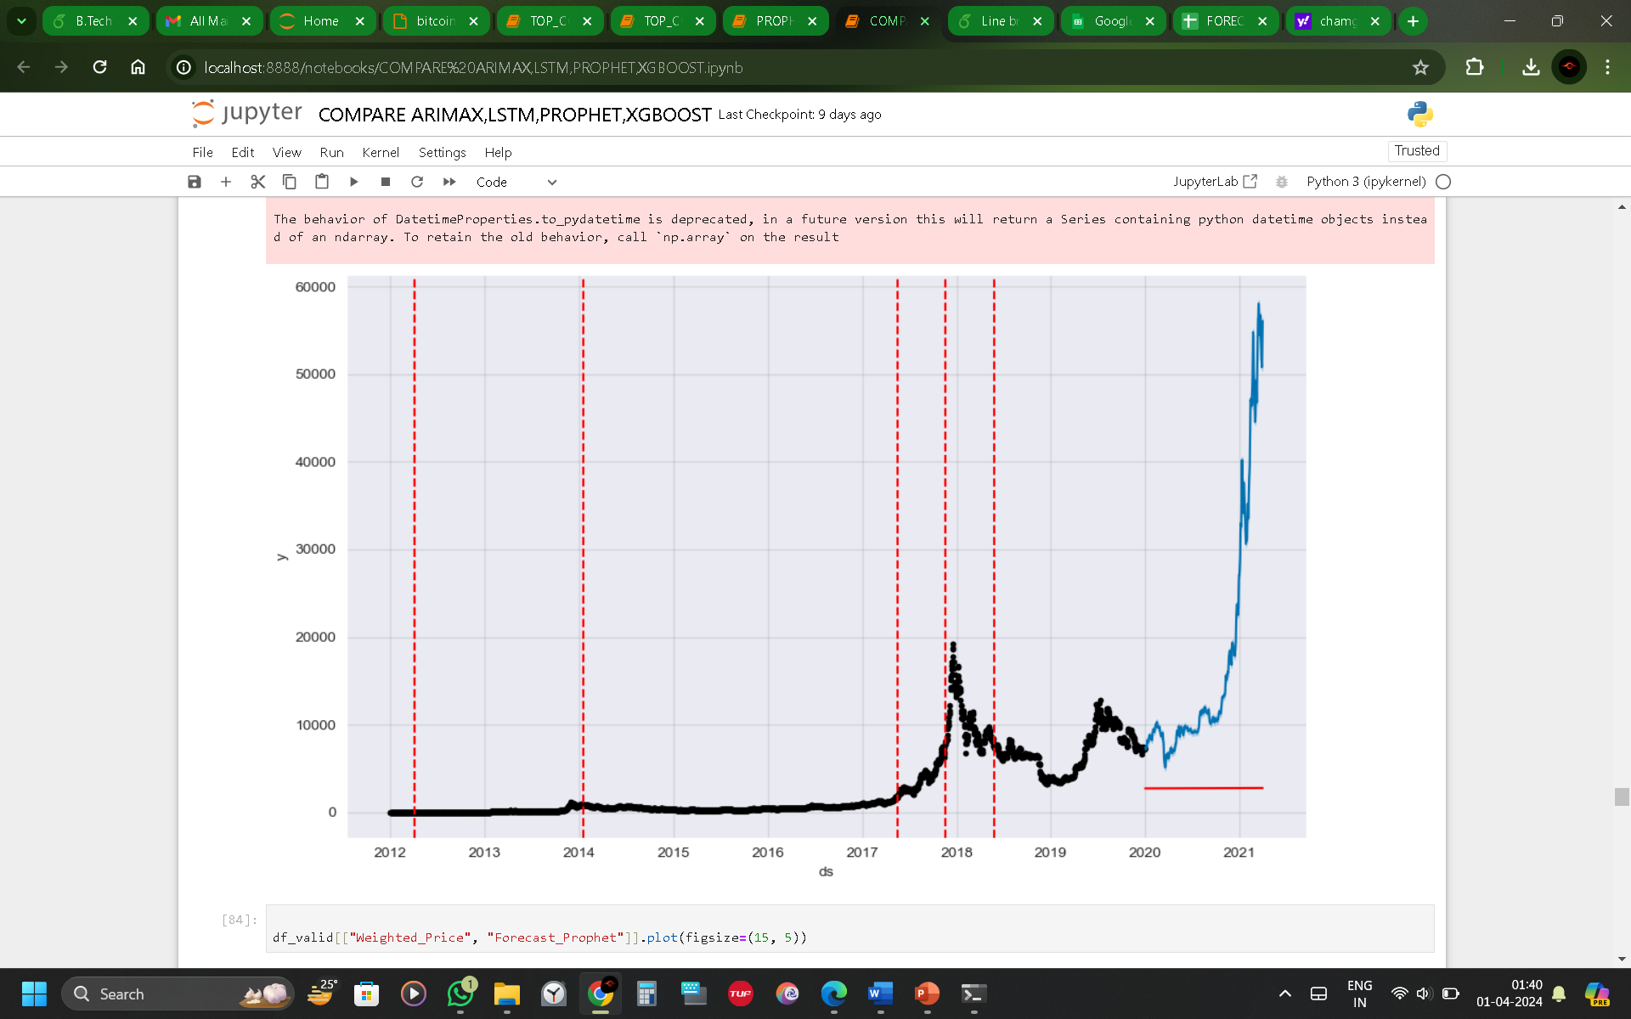
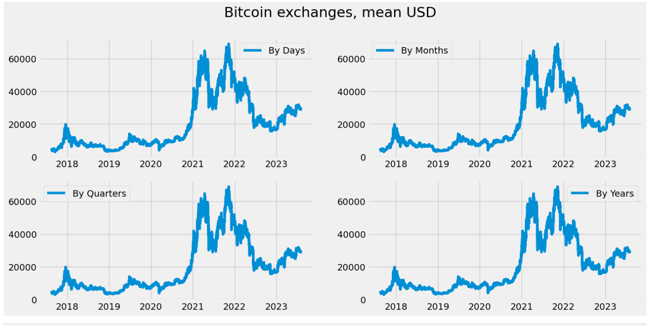
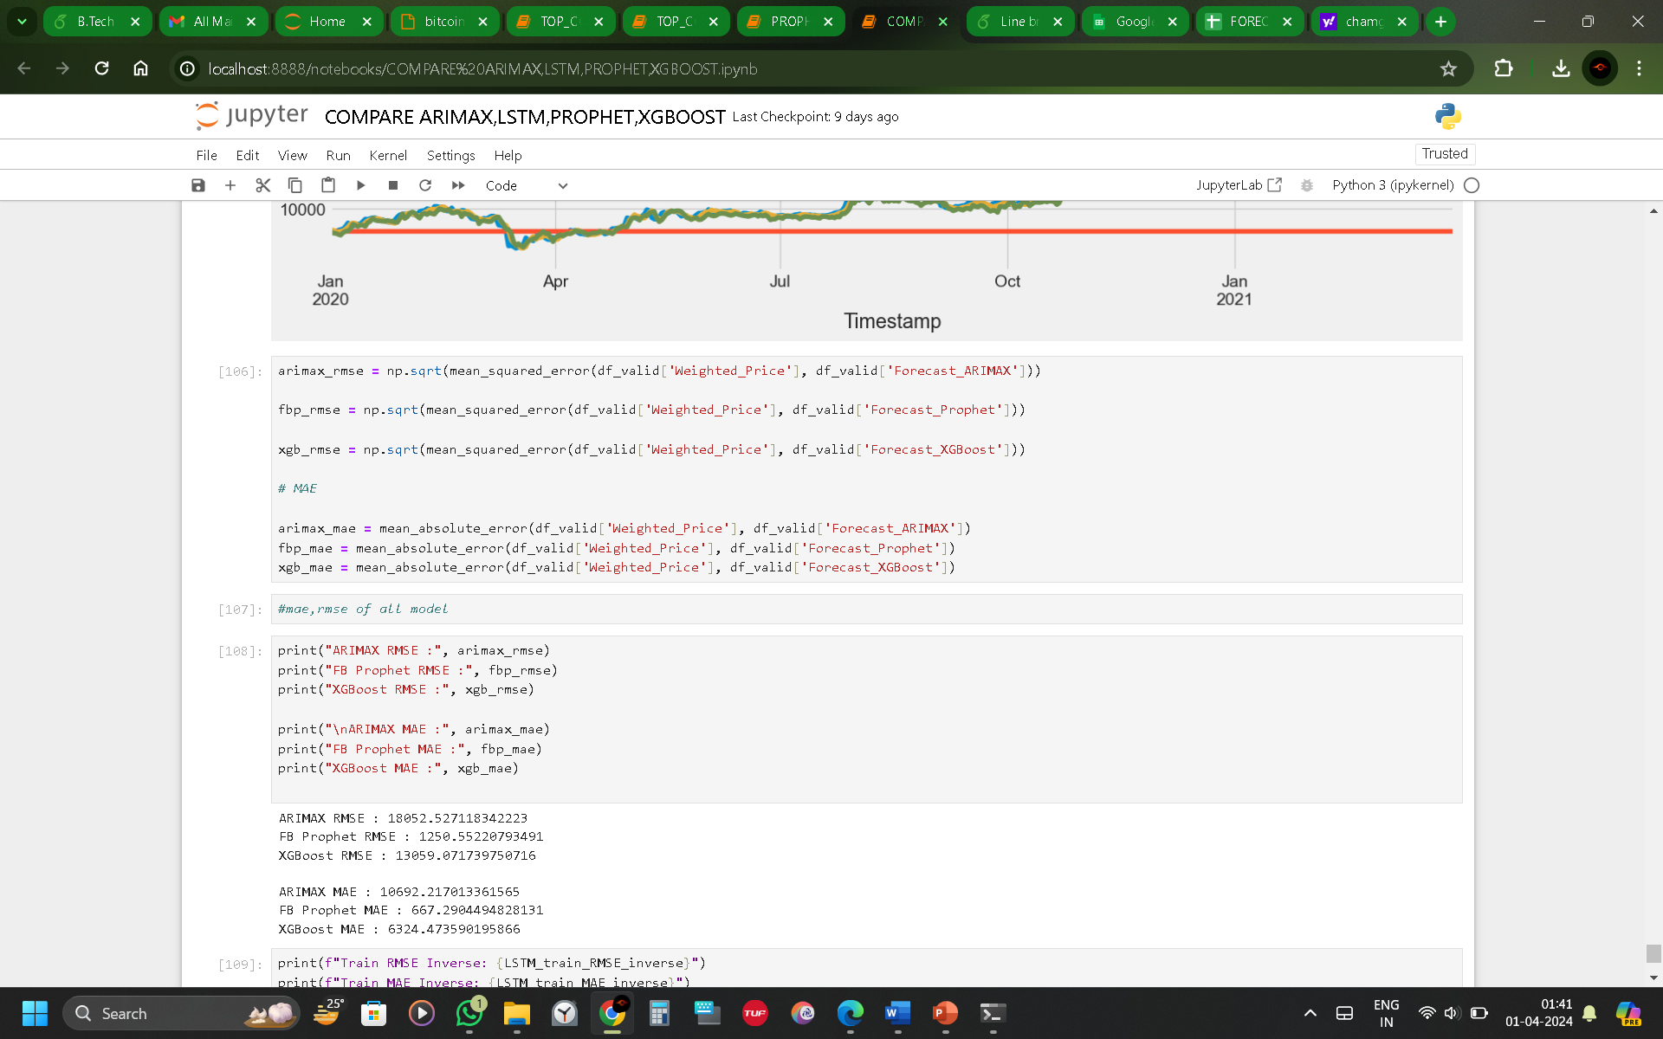
05
IMPLEMENTATION

Slide 12
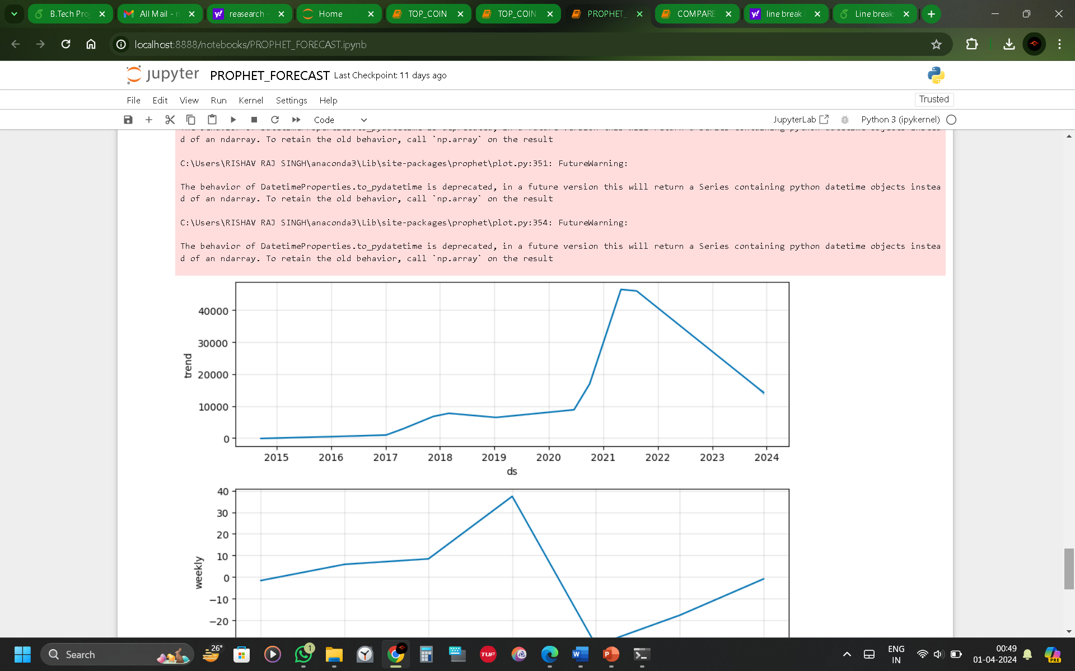
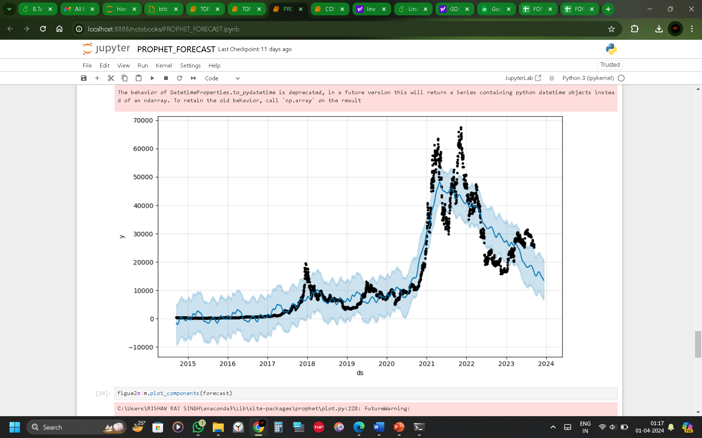
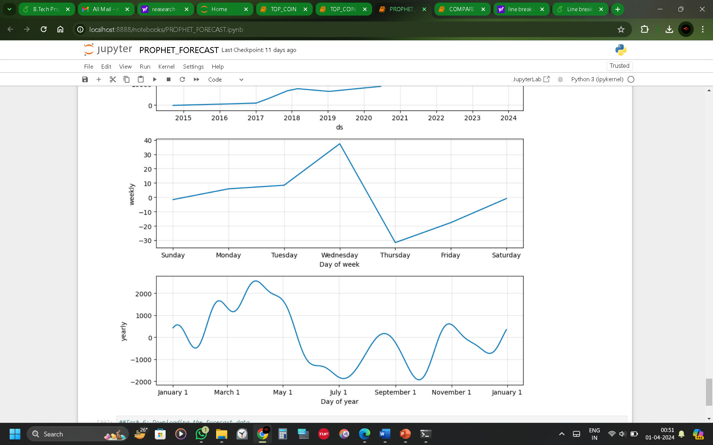
06
RESULT AND EVALUATION

Slide 13
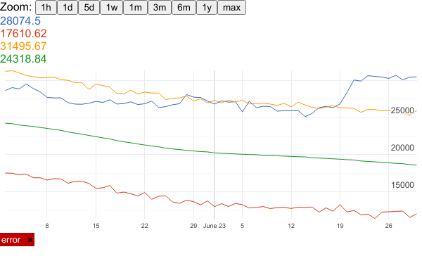
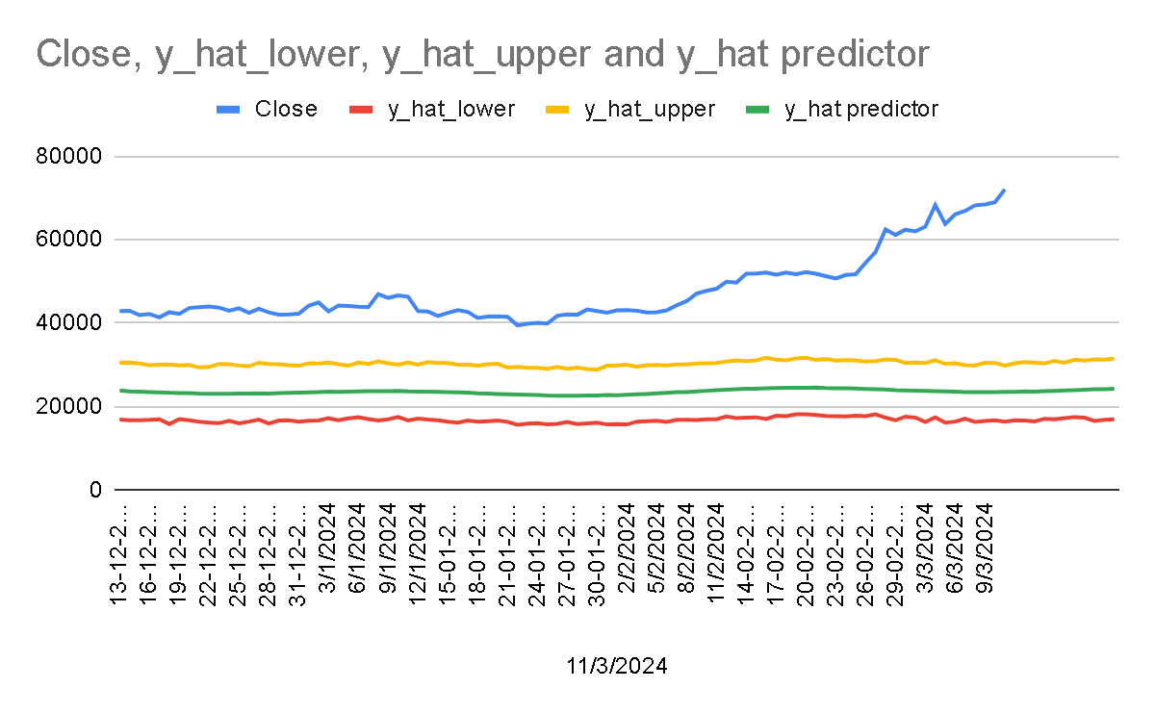
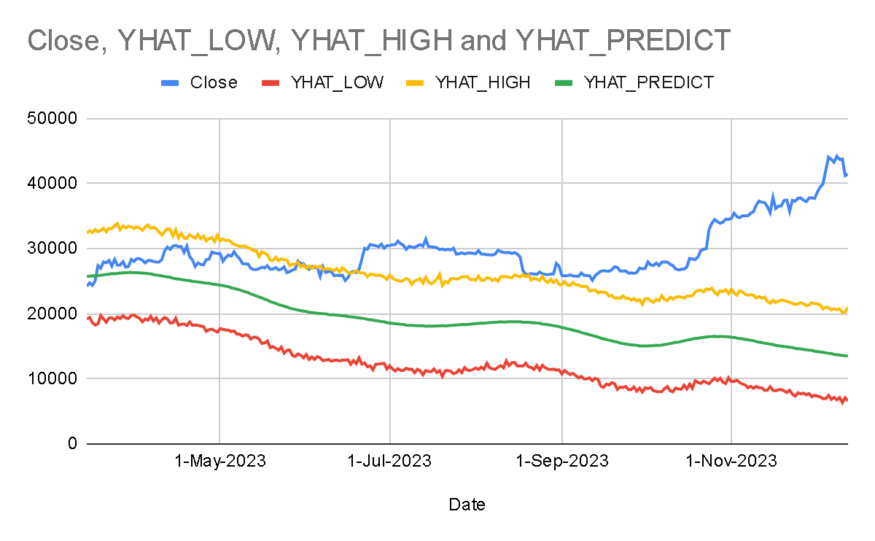
06
RESULT AND EVALUATION

Slide 14
08
DISCUSSION
The future scope of this project could involve expanding the model to predict prices of other cryptocurrencies, thereby providing a comprehensive tool for cryptocurrency investors. Additionally, the model could be enhanced by incorporating more complex machine learning algorithms or by integrating real-time data feeds for more accurate and timely predictions.
Furthermore, the research could delve deeper into the impact of global events on Bitcoin prices, adding the oil and gold price and daily news providing a more holistic view of the factors influencing cryptocurrency markets. This could involve the use of Natural Language Processing (NLP) techniques to analyze news articles or social media posts related to cryptocurrencies.
Finally, the project could explore the development of a user-friendly application or platform that utilizes the predictive model, making it accessible to a wider audience. This could potentially democratize access to cryptocurrency investment tools, contributing to the growth and maturity of the cryptocurrency market.

Slide 15
09
CONCLUSIONS
The primary objective of developing a predictive model for Bitcoin prices has been achieved. The model caters to diverse needs such as investment decision-making, risk management, algorithmic trading, portfolio optimization, market analysis, financial planning, cryptocurrency exchange operations, regulatory compliance, and risk assessment in derivative trading.
This research project has not only contributed to the advancement and understanding of cryptocurrency markets in the digital era but also provided a valuable tool for stakeholders in the cryptocurrency domain.
The predictive model developed in this study can serve as a reliable guide for financial investors, aiding them in making informed decisions in the dynamic world of cryptocurrency trading.
The research’s findings underscore the potential of machine learning algorithms in forecasting Bitcoin prices and highlight the importance of continuous innovation in this rapidly evolving field.
The model’s ability to set upper and lower limits for price fluctuations is a novel approach that can aid investors in risk management and decision-making processes. This feature can mitigate the risk factor when the Bitcoin price exceeds the upper limit and prevent a sudden market crash when it exceeds the lower limit.

